Slide 1
Battle of the Neighborhoods
Toronto

Slide 2
Introduction
What is the most common type of venues visited in Toronto
How is the distribution along the different boroughs of Toronto

Slide 3
Data
The Data was gathered from several sources such as Wikipedia and Foursquare API and analyzed and visualized and improved using machine learning

Slide 4
Methodology
We get the data from Wikipedia
We sort and manipulate the data with python
We create a map of Toronto
We work with Foursquare to get most common venues in Toronto
We use machine learning to create several clusters
We visualize the data and view it as a table

Slide 5
Results
The results will be shown as images taken from the Jupiter Notebook

Slide 6
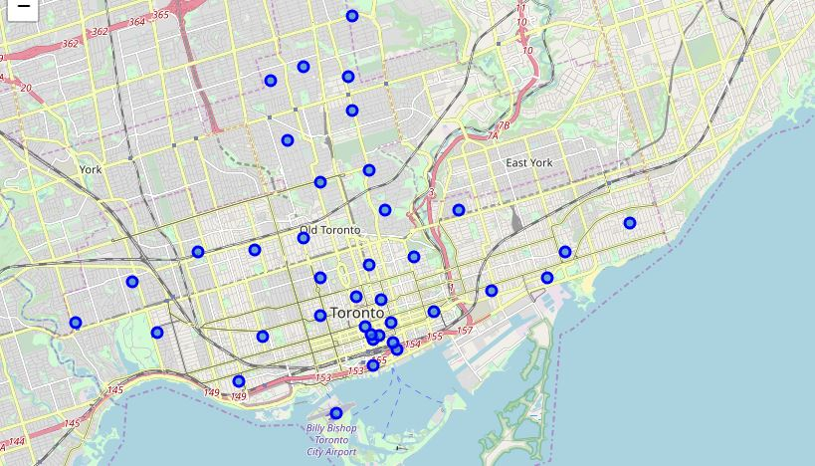
Map Showing Neighborhoods in toronto

Slide 7
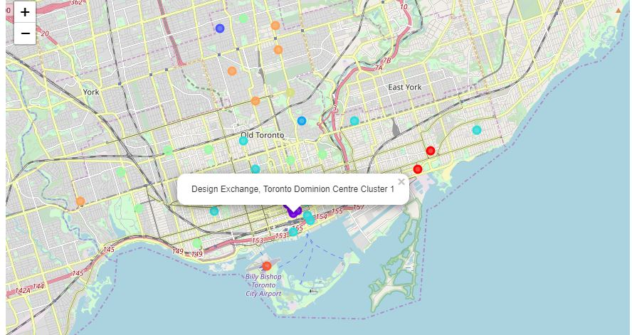
Map of t0ronto after clustering

Slide 8
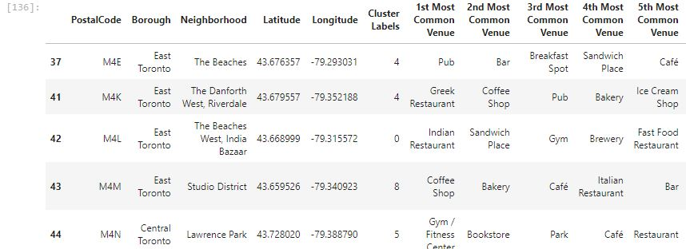
Table of Most common Venues

Slide 9
Analysis
We notice that the most popular venues either have to do with either drinking or food
This is helpful so that anyone interested in creating a business has to create a business involving these categories in a certain neighborhood

Slide 10
Conclusion
This capstone has made me use the different aspects of data science to create a whole project

